Slide 1
EXPLORATORY DATA ANALYTICS SPOTIFY DATA ANALYSIS
TEAM MEMBERS:
JEEVAN V: (2411021061541)
NITHIN J: (2411021061628)
PANCHAKSHARI S HIREMATH :(2411021061638)
AVINASH KR: (2411021061614)

Slide 2
INTRODUCTION:
This dataset contains information about songs such as popularity, genre, tempo, and other music features.
The aim of this analysis is to understand patterns in music and factors affecting song popularity.
Python libraries like Pandas, Matplotlib, and Seaborn are used for analysis and visualization.
Different graphs are created to explore relationships between music features.
The analysis helps identify trends and insights in the music dataset.

Slide 3
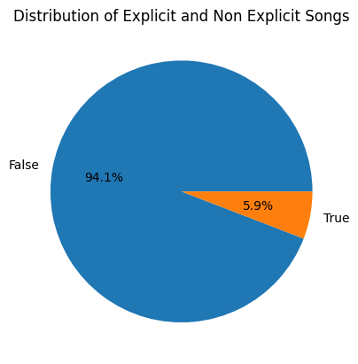
Pie Chart – Distribution of Explicit and Non Explicit Songs
This pie chart shows the proportion of songs that contain explicit content versus those that do not. From the chart, around 94% of songs are non-explicit, while about 6% contain explicit lyrics. This indicates that most songs in the dataset are suitable for a general audience.

Slide 4
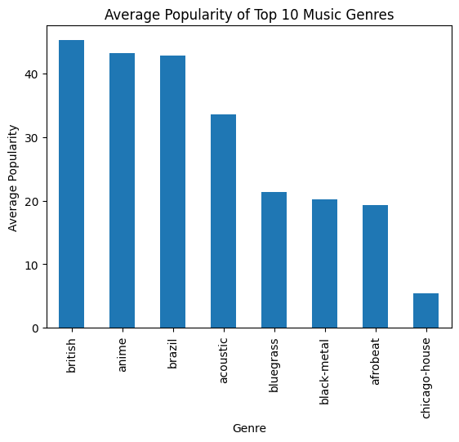
Bar Graph – Average Popularity of Top 10 Music Genres
This bar chart shows the average popularity score of the top 10 music genres in the dataset. It helps identify which genres tend to perform better with listeners. Higher bars represent genres that are generally more popular among audiences.

Slide 5
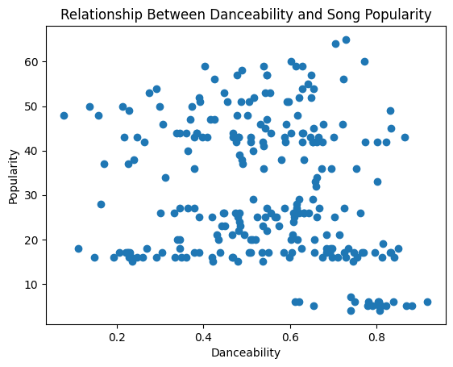
Scatter Plot – Danceability vs Song Popularity
This scatter plot shows the relationship between danceability and popularity of songs. Each point represents a song. If points trend upward, it suggests that songs that are easier to dance to tend to have higher popularity.

Slide 6
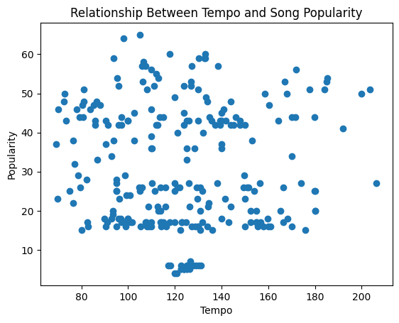
Scatter Plot – Tempo vs Song Popularity
This graph compares song tempo (speed of music) with popularity. It helps determine whether faster or slower songs are more popular. The spread of points shows how tempo varies among songs with different popularity levels.

Slide 7
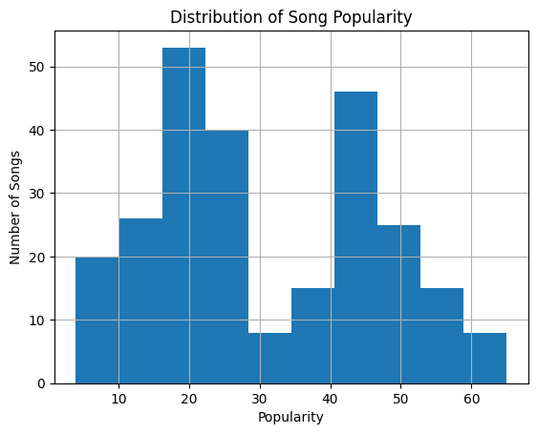
Distribution of Song Popularity
This histogram shows how song popularity scores are distributed in the dataset. It helps identify whether most songs have low, medium, or high popularity. Peaks in the bars represent the most common popularity ranges.

Slide 8
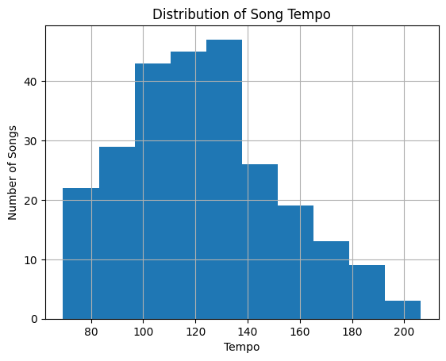
Distribution of Song Tempo
This graph displays how tempos are distributed across songs. It shows whether most songs fall within a slow, medium, or fast tempo range.

Slide 9
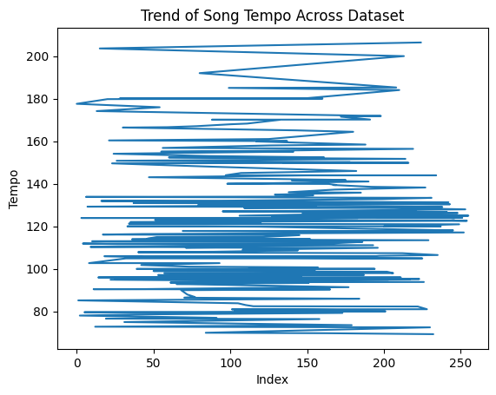
Trend of Song Tempo Across Dataset
This line graph shows how tempo values change across songs in the dataset. It helps visualize patterns or fluctuations in tempo throughout the dataset.

Slide 10
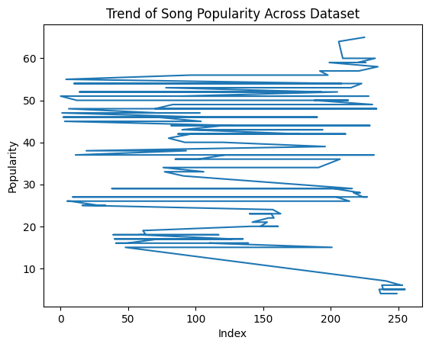
Trend of Song Popularity Across Dataset
This chart shows how song popularity varies across the dataset. The line helps visualize changes in popularity levels from one song to another.

Slide 11
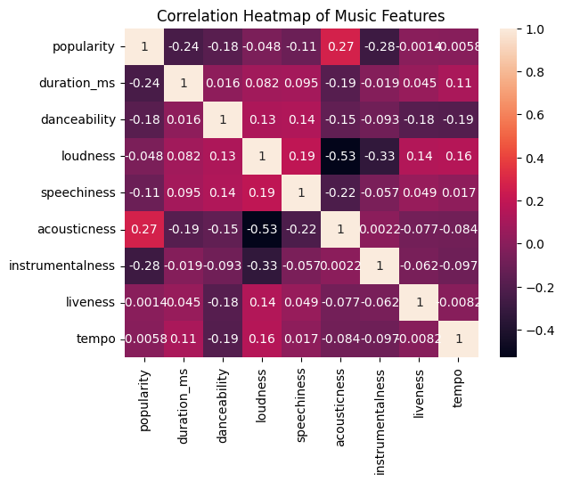
Heatmap – Correlation of Music Features
The heatmap shows the correlation between different music features such as popularity, danceability, loudness, and tempo.
Values close to 1 indicate strong positive correlation.
Values close to -1 indicate negative correlation.
Values near 0 indicate little or no relationship.

Slide 12
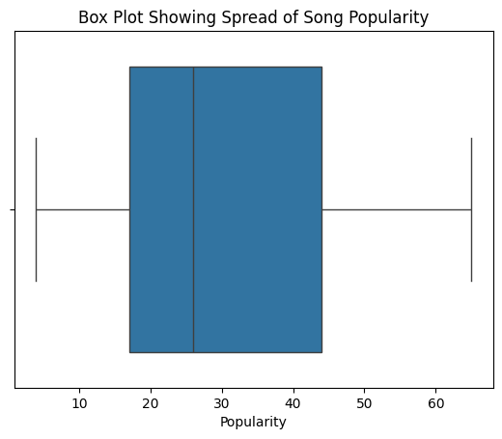
Spread of Song Popularity
The box plot shows the distribution and spread of song popularity. It highlights the median, quartiles, and possible outliers, helping identify whether some songs have extremely high or low popularity.

Slide 13
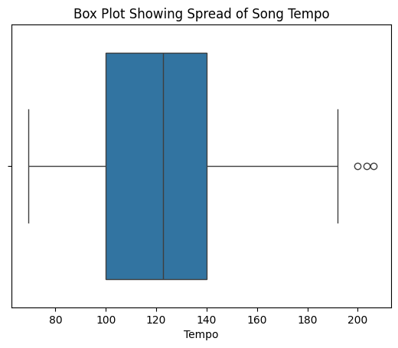
Spread of Song Tempo
This box plot shows the variation in tempo among songs. It helps identify the typical tempo range and detect songs with unusually high or low tempo.

Slide 14
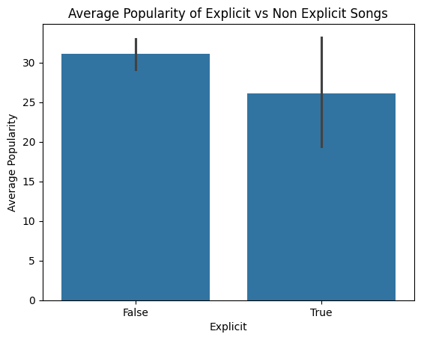
Popularity of Explicit vs Non Explicit Songs
This graph compares the average popularity of explicit and non-explicit songs. It helps determine whether songs with explicit lyrics tend to be more or less popular compared to clean songs.

Slide 15
CONCLUSION
Most songs in the dataset are non-explicit, showing that clean songs are more common.
Some music genres have higher average popularity, indicating audience preference for certain styles.
Features like danceability and tempo show some relationship with song popularity.
The correlation heatmap helps identify relationships between different music features.
Overall, data visualization helps understand patterns and trends in music popularity and characteristics.

Slide 16
CODE LINK
https://colab.research.google.com/drive/1Eow5_Vp1MXOubfx3DEaZkEsuvB5bEwnQ#scrollTo=E-gbEzi4rhhg

Slide 17
THANK YOU

